Slide 1

Integrated Communications Network Using Surface Waves
Çağın Sarı (Cagin Sari)
Notes:
Good morning!
I am going to present DP
About Integrated Communications Network using surface waves

Slide 2
Flow of The Presentation
Substrate Height and Dielectric Permittivity Decision
Antenna in Reception
Receive Antenna Orientation For Maximum Power
Power Received With Increasing Radial Distance
Power Received With Incident Azimuthal Angle
Notes:
During the presentation I will go through
How I selected my thickness and permittivity
Than I am going to present Antenna in reception, where the formulation for received power is made
Dipole orientation for max Rx power
Change in the received power with azimuthal angle

Slide 3
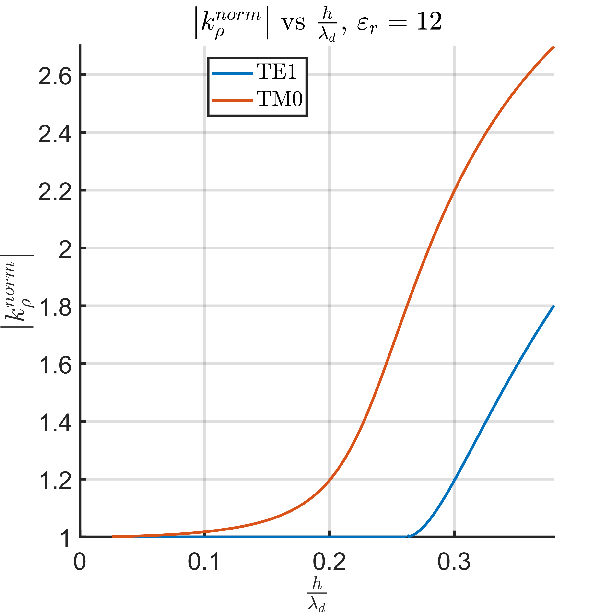
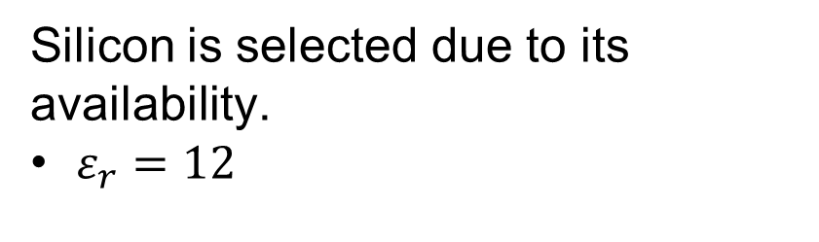
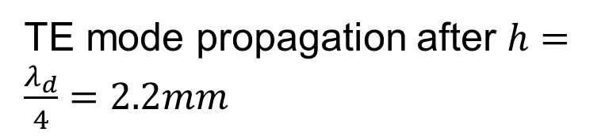
Substrate Height And Permittivity Decision
Silicon is selected due to its availability.
$ε_{r}=12$
1905-1986:
Delft Institute of Technology
1842-1864:
Royal Academy
TM0 mode is desired
Higher surface wave radiation power
Starts propagation before TE mode.
TE mode propagation after $h=\frac{λ_{d}}{4}=2.2mm$
Notes:
Silicon has been selected for substrate and its relative permittivity is er=12.
TM0 mode is desired:
More power is launched into the TM0 mode compared to TE1
It starts to propagate much before TE1 so in the absence of TE1
TE mode starts to propagate after 0.25lambda_d therefore the thickness is selected to be 2.2mm

Slide 4
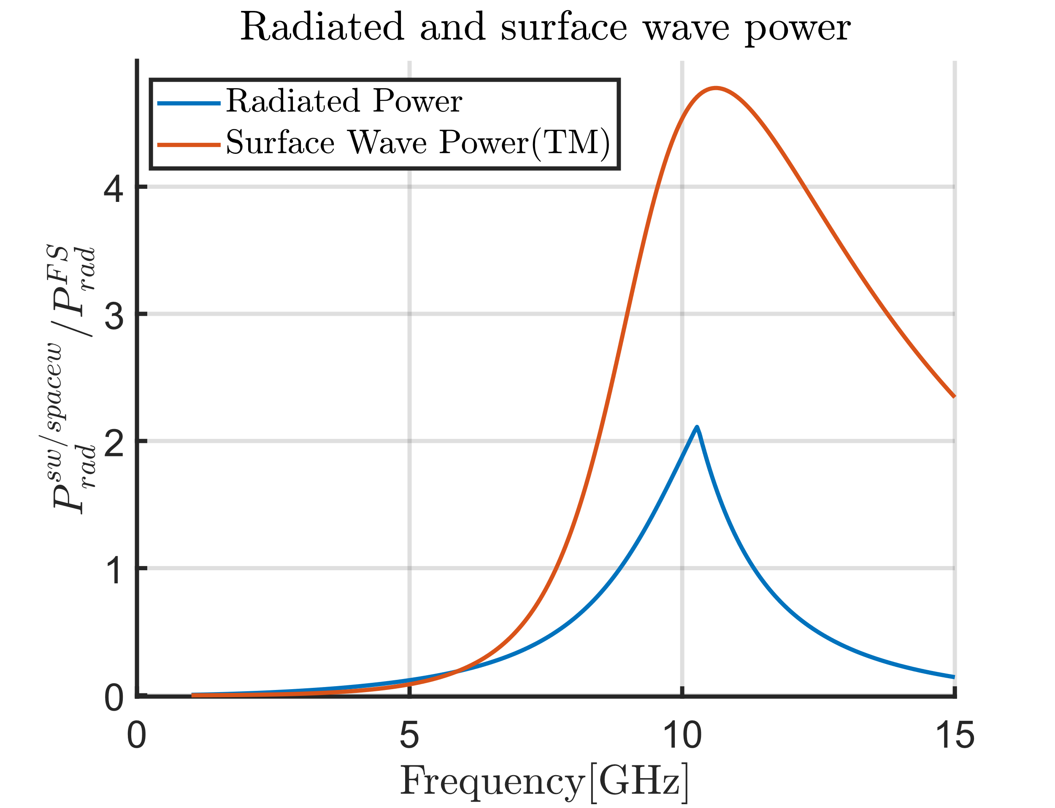
Substrate Height And Permittivity Decision
Silicon is selected due to its availability.
$ε_{r}=12$
1905-1986:
Delft Institute of Technology
1842-1864:
Royal Academy
TM0 mode is desired
Higher surface wave radiation power
Starts propagation before TE mode.
TE mode propagation after $h=\frac{λ_{d}}{4}=2.2mm$
Notes:
In the figure it could also be seen that surface wave power is much larger than radiated power

Slide 5
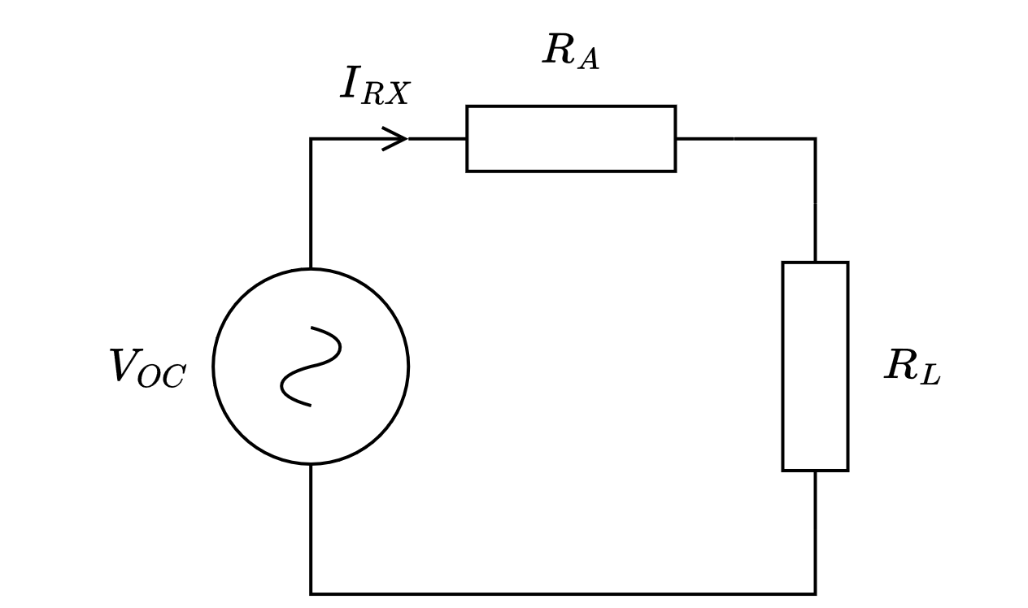
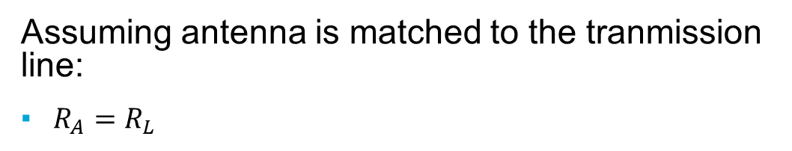
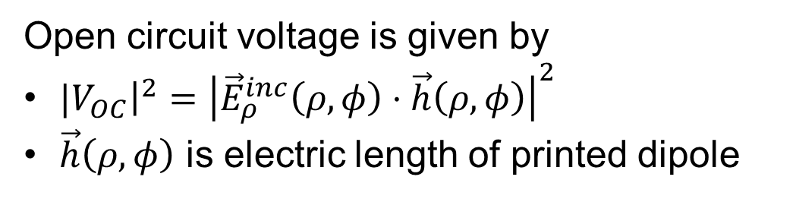
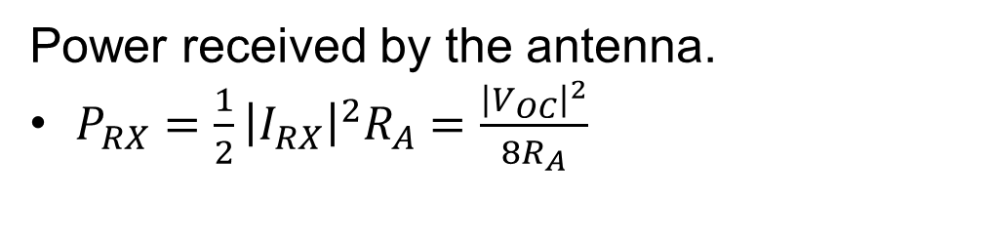
Antenna In Reception
Assuming antenna is matched to the tranmission line:
$R_{A}=R_{L}$
Power received by the antenna.
$P_{RX}=\frac{1}{2}{\left|I_{RX}\right|}^{2}R_{A}=\frac{{\left|V_{OC}\right|}^{2}}{8R_{A}}$
Open circuit voltage is given by
${|V}_{OC}{\left.​\right|}^{2}={\left|{\vec{E}}_{ρ}^{inc}\left(ρ,φ\right)⋅\vec{h}\left(ρ,φ\right)\right|}^{2}$
$\vec{h}\left(ρ,φ\right)$ is electric length of printed dipole
Notes:
The Equivalent circuit for the antenna under reception
Given Top right corner
It is assumed that antenna is perfectly matched to the transmission line so that RA =RL
The received power is given by Voc squred over 8Ra
Where Voc is given by the dot product between electric length of the antenna and incident e-field in rho direction
Feedback: revise the concept of electrical length of the dipole.

Slide 6
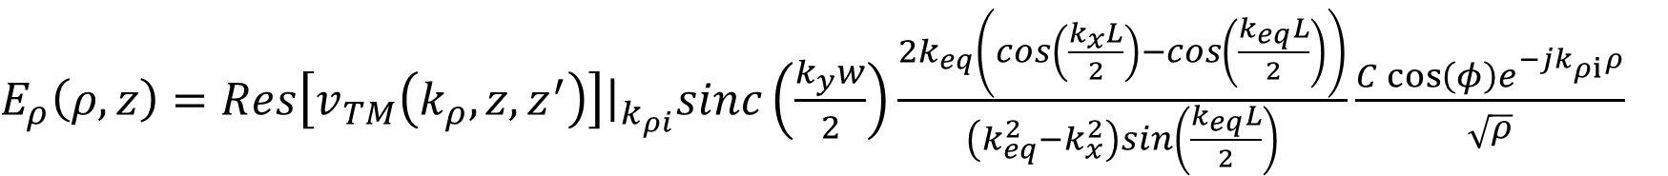
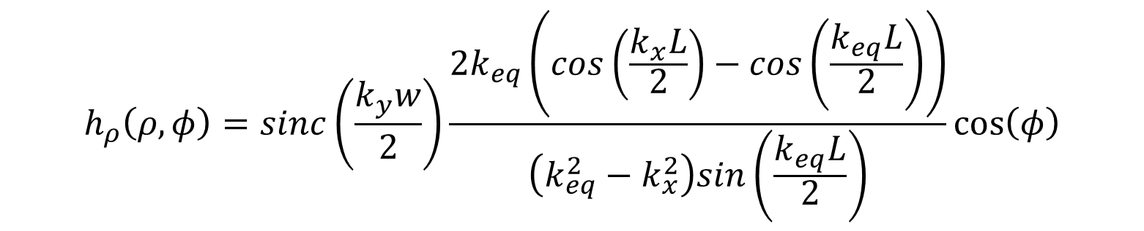
Antenna In Reception
Electric field incident on printed dipole
$E_{ρ}\left(ρ,z\right)=Res\left[v_{TM}\left(k_{ρ}, z,z^{′}\right)\right]{\left.​\right|}_{k_{ρi}}sinc\left(\frac{k_{y}w}{2}\right)\frac{2k_{eq}\left(cos\left(\frac{k_{x}L}{2}\right)−cos\left(\frac{k_{eq}L}{2}\right)\right)}{\left(k_{eq}^{2}−k_{x}^{2}\right)sin\left(\frac{k_{eq}L}{2}\right)}\frac{C\cos\left(φ\right)e^{−jk_{ρi}ρ}}{\sqrt{ρ}}$
Electric length of the dipole
$$h_{ρ}\left(ρ,φ\right)=sinc\left(\frac{k_{y}w}{2}\right)\frac{2k_{eq}\left(cos\left(\frac{k_{x}L}{2}\right)−cos\left(\frac{k_{eq}L}{2}\right)\right)}{\left(k_{eq}^{2}−k_{x}^{2}\right)sin\left(\frac{k_{eq}L}{2}\right)}\cos\left(φ\right)$$
Notes:
The Efield incident on the antenna is given by the equation on top where the electric length of the dipole is given by the lower equation
Note: Remove vector notation since you stated that it is in rho direction in the subscript and there is no vector in the equation.

Slide 7
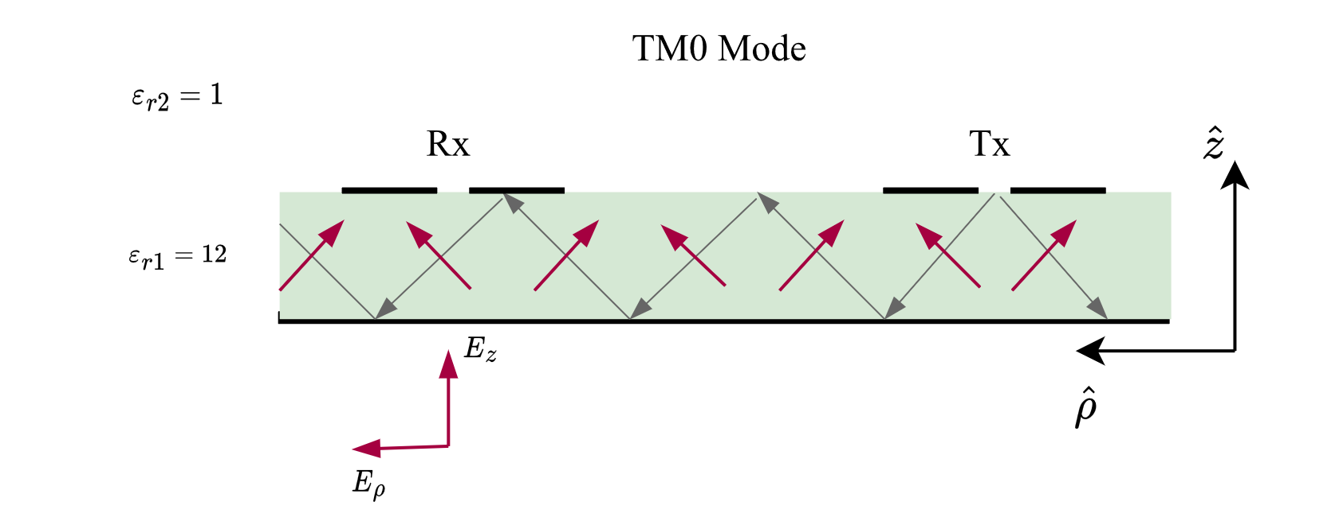
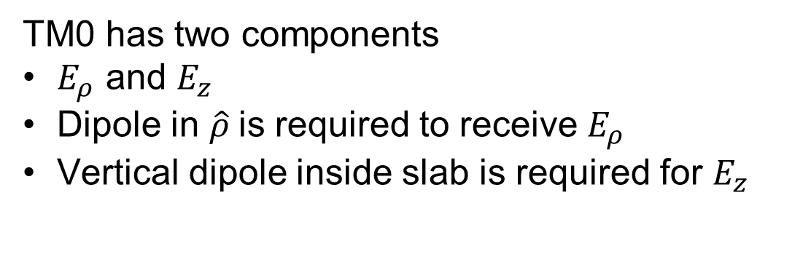
Receive Antenna Orientation For Maximum Power
TM0 has two components
$E_{ρ}$ and $E_{z}$
Dipole in $\hat{ρ}$is required to receive $E_{ρ}$
Vertical dipole inside slab is required for $E_{z}$
Notes:
As shown on the figure the TM0 mode has two electricfield components Erho and Ez. To recceivive max power the receiving antenna has to be In the rho direction. To receive the field in z direction vertical dipole needs to be embedded inside the dielectric

Slide 8
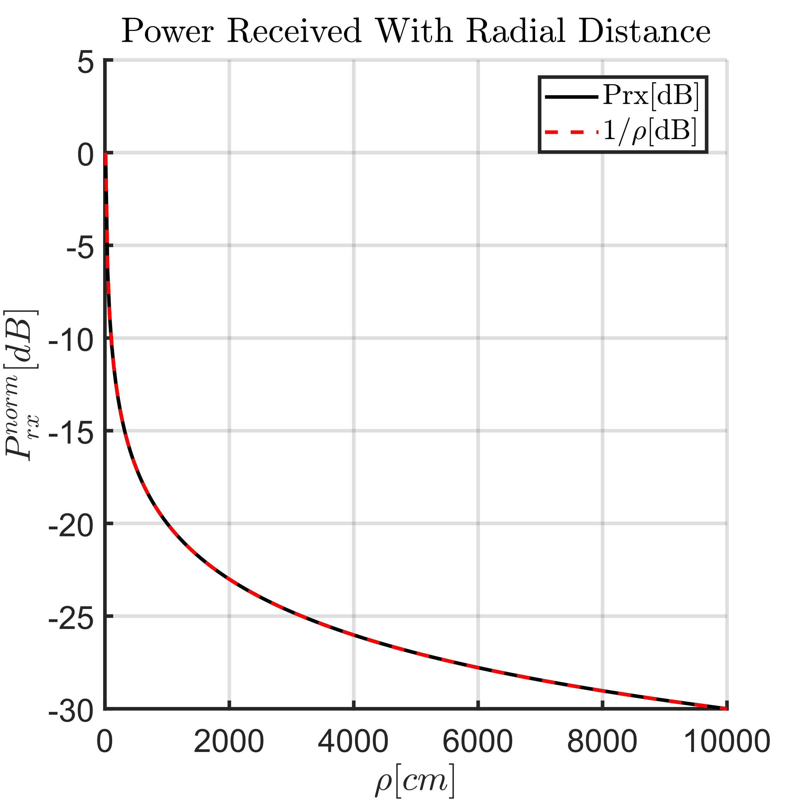
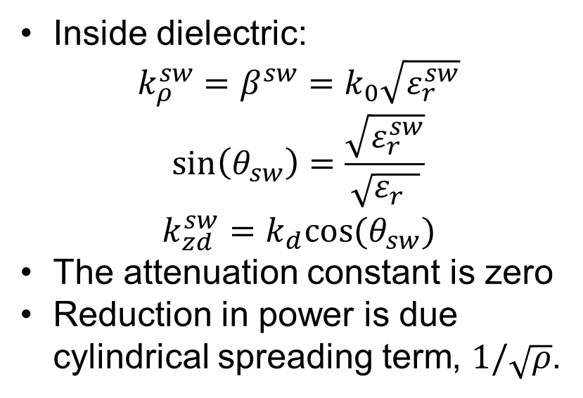
Power Received With Increasing Radial Distance
Inside dielectric:
$$k_{ρ}^{sw}=β^{sw}=k_{0}\sqrt{ε_{r}^{sw}}$$
$$\sin\left(θ_{sw}\right)=\frac{\sqrt{ε_{r}^{sw}}}{\sqrt{ε_{r} }}$$
$$k_{zd}^{sw}=k_{d}cos⁡(θ_{sw})$$
The attenuation constant is zero
Reduction in power is due cylindrical spreading term, $1/\sqrt{ρ}$.
Notes:
The surface wave propagation constant is purely real inside the dielectric therefore attenuation constant is zero
Reductoion in power is due to cylindrical spreading of the surface waves.
Feedback: Change the range from 10 cm to 15 cm

Slide 9
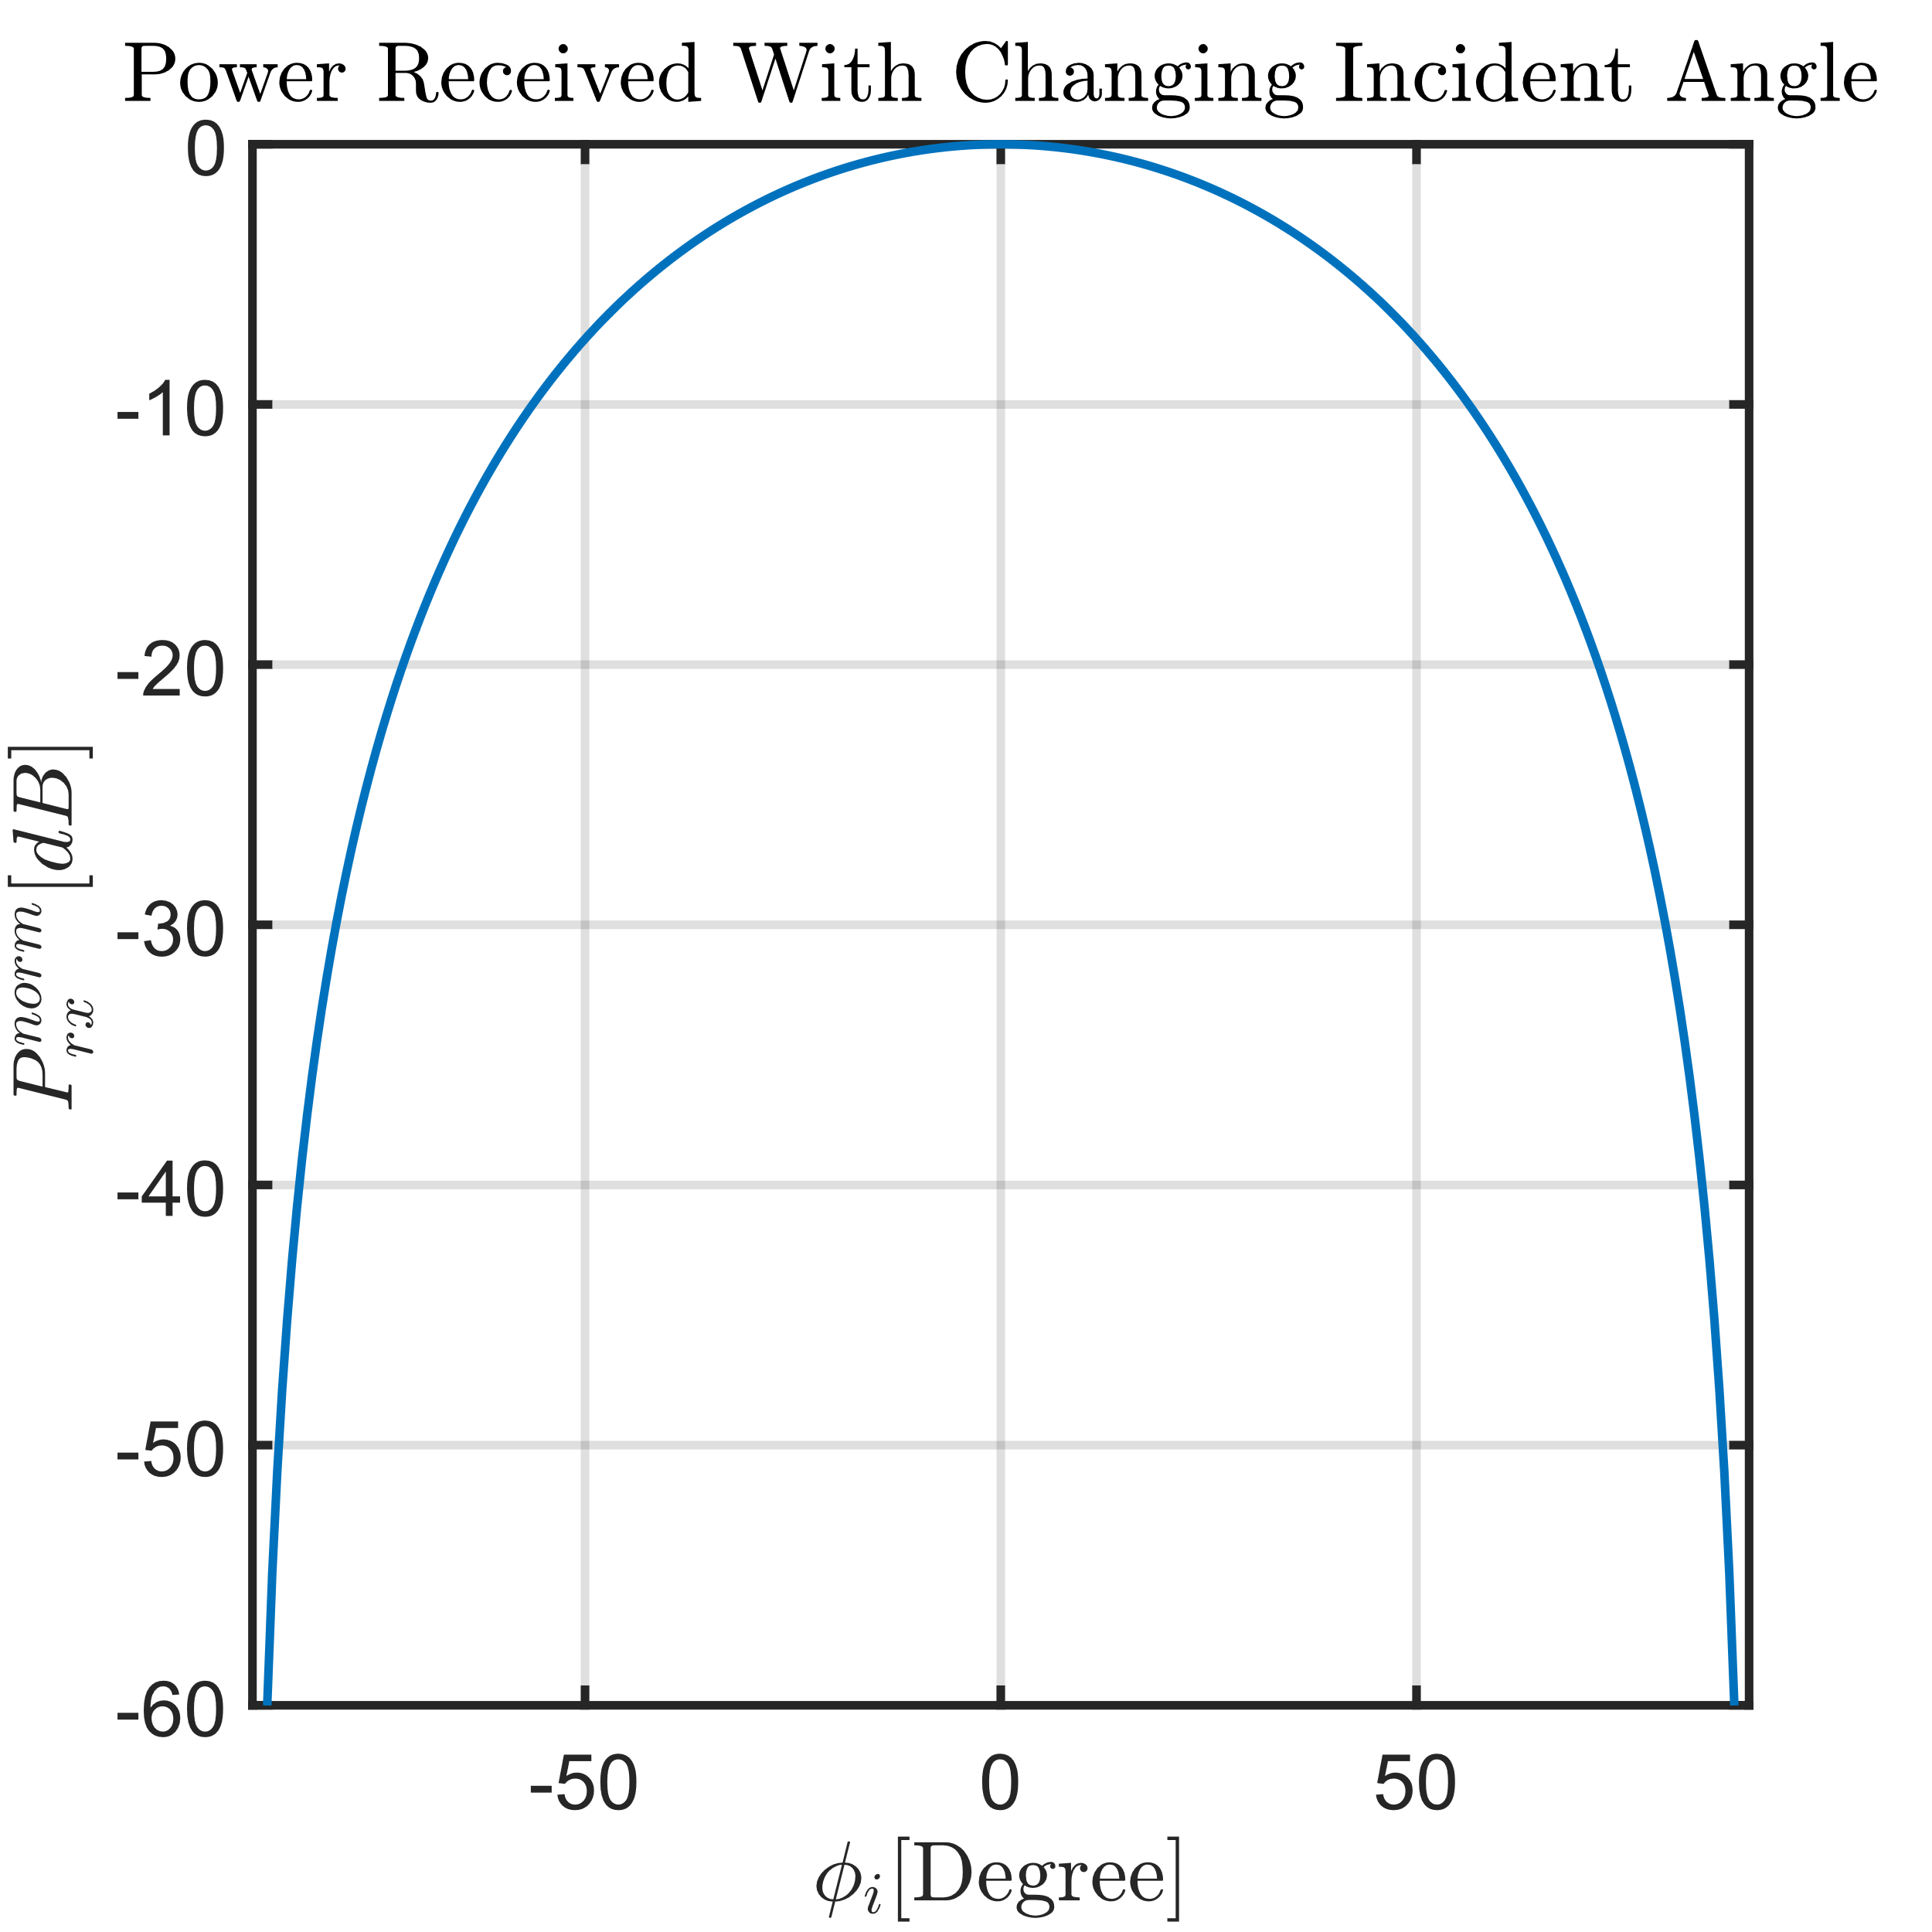
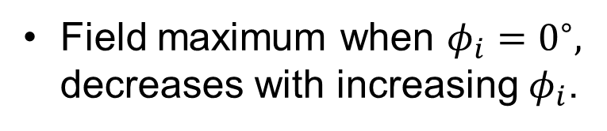
Power Received With Incident Azimuthal Angle
Field maximum when $φ_{i}=0^{∘},$ decreases with increasing $φ_{i}$.
Notes:
Feedback: Add unnormalized received power

Slide 10
Conclusion
The system will be highly dependent on polarisation.
The power in of the surface wave in z direction is not received unless a vertical dipole is embedded into the substrate
The system can be useful for integrated devices since only reduction in power is resulting from cylindrical spreading
Some action is required to prevent space radiated power, to prevent damage to other circuit elements.
Notes:
Feedback: Revise the conclusion section, use the electric field to describe the changes in reception instead of using electric field and power interchangeably.

Slide 11
Thank you for your attention
#betterTUgether

